Slide 1

Money Is for Lunatics
Demanders and Suppliers of Money
Copyright: www.123rf.com/weyo /123RF Stock Photo

Slide 2
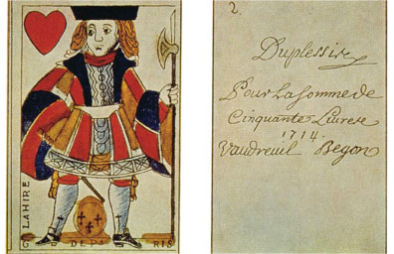
DEMAND FOR MONEY
People demand money for its liquidity as a medium of exchange, unit of account, and store of value, and are often willing to give up interest on bonds in order to hold their wealth as money.

Slide 3
Money anything acceptable as means of payment; money has three functions
Medium of exchange — acceptability solves barter problem of double coincidence of wants
Unit of account — standard unit for measuring prices
Store of value — time machine for moving purchasing power from present to future; you can earn now and spend later

Slide 4

Bond financial asset for which borrower promises to repay the original value at a specific future date, and to make fixed regular interest payments

Slide 5
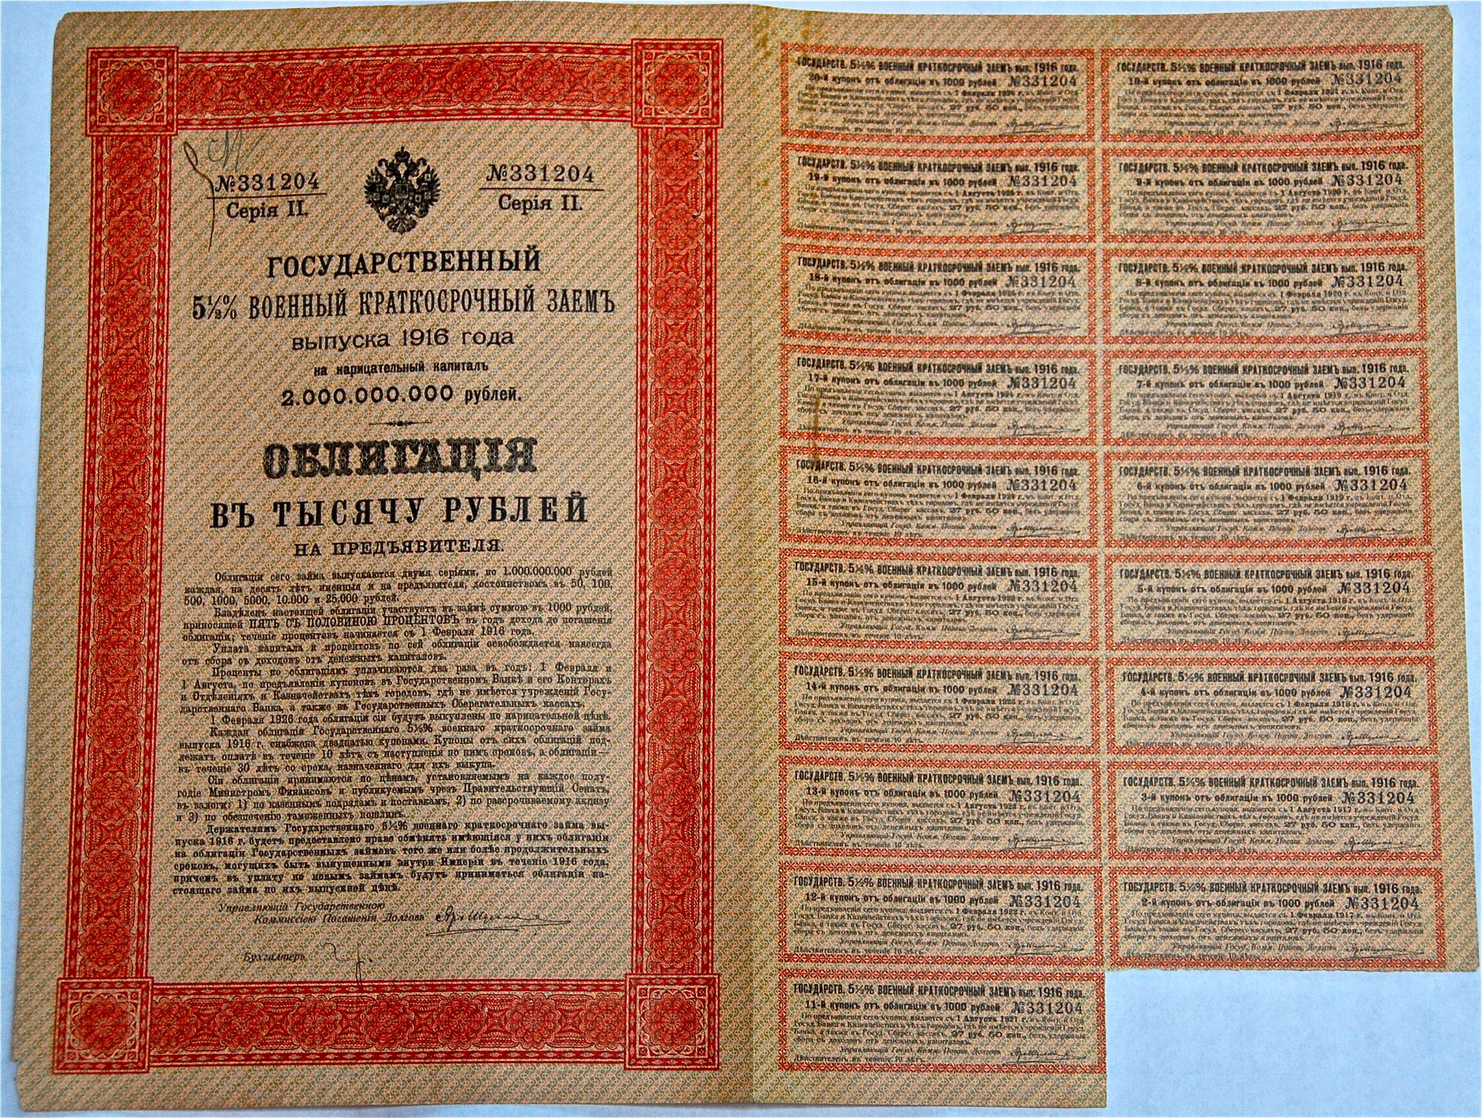

Slide 6
Demand for money is about the choice — to hold your wealth as money or as bonds ?
Why hold wealth as money that pays no interest, rather than as bonds that pay interest?
Money provides liquidity — ease with which assets can be converted into the medium of exchange
Money is the most liquid asset — acceptable by sellers as means of payment
Money pays no interest, but has liquidity
Bonds pay interest, but do not have liquidity

Slide 7
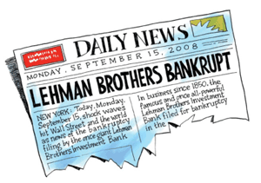
Why hold money as a store of value?
For Yes — Markets Self-Adjust camp, people hold more wealth as interest-paying bonds, since savings safely invested in loanable funds (bonds)
For No — Markets Fail Often camp, people hold more wealth as money because fundamental uncertainty about future makes bond investments risky

Slide 8
Interest rate price of holding money; what you give up by not holding bonds
Determined by demand and supply in both money and loanable funds markets
Law of demand for money as the price of money — the interest rate — rises, the quantity demanded of money decreases

Slide 9
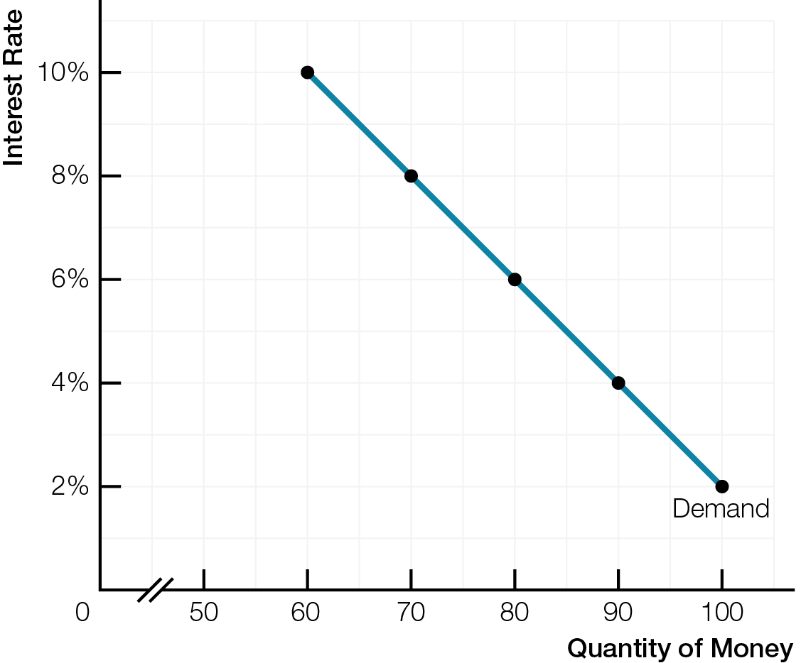
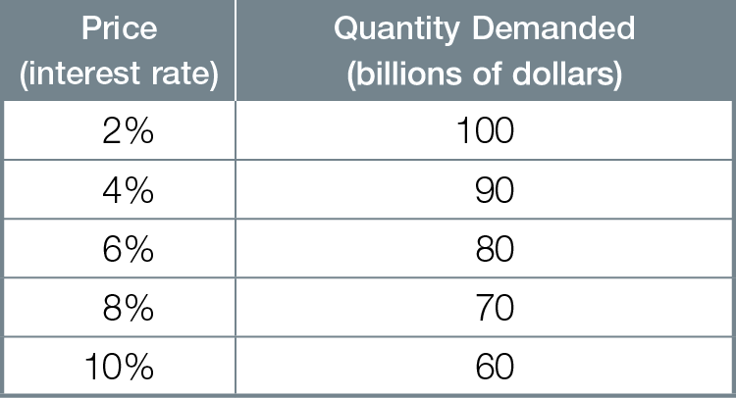
Demand for Money

Slide 10
Changes in real GDP or average prices cause change in demand for money (shift of demand curve)
Increase in demand for money (rightward shift) from
Increase in real GDP
Rise in prices
Decrease in demand for money (leftward shift) from
Decrease in real GDP
Fall in prices

Slide 11
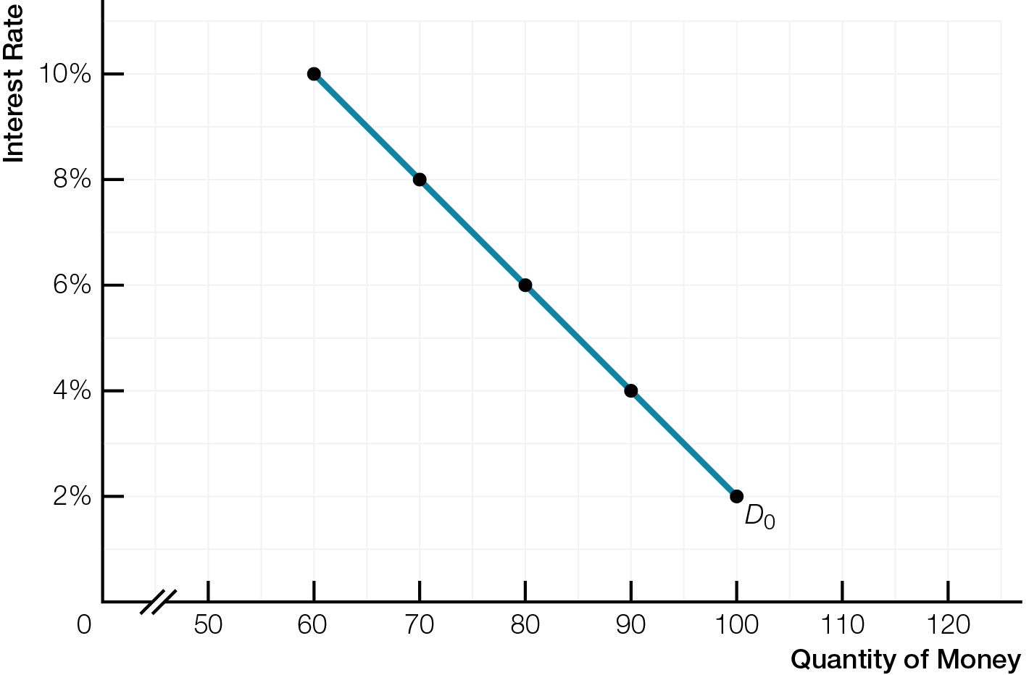
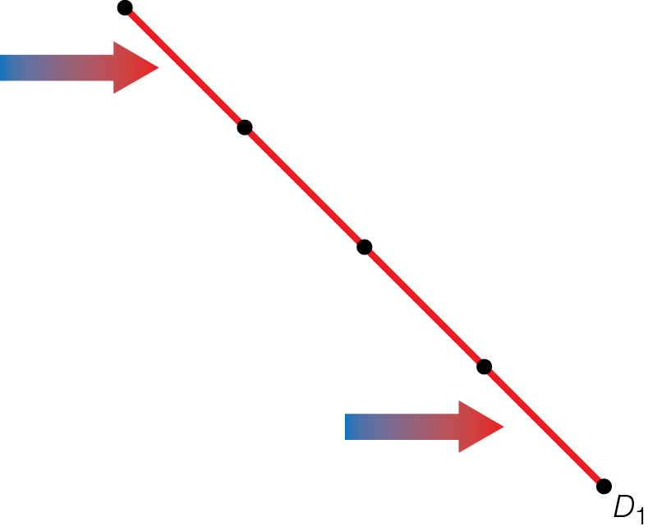
An Increase in the Demand for Money
Fig. 9.2

Slide 12
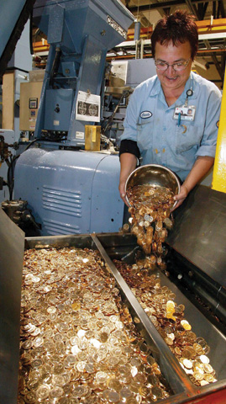
SUPPLY OF MONEY
In a fractional-reserve banking system, the supply of money — currency plus demand deposits — is created both by the Bank of Canada and by chartered banks making loans.

Slide 13
Forms of money
Commodity money — saleable product with alternative uses
Convertible paper money — paper money converted into gold on demand
Fiat money — currency (government-issued bills and coins) with no alternative uses; valuable simply by government decree
Deposit money — demand deposits balances in bank accounts that depositors withdraw on demand by using a debit card or cheque

Slide 14
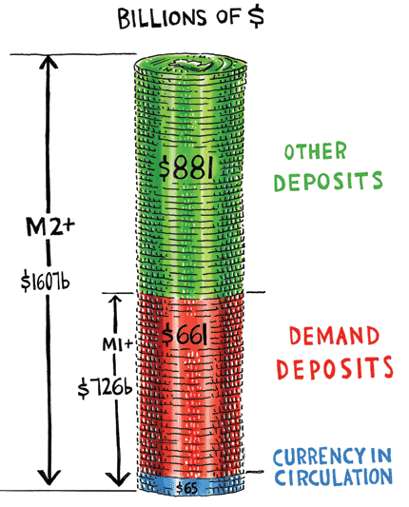
The Money Supply
Supply of money is currency and deposit money
M1+ = currency in circulation plus demand deposits
M2+ = M1+ plus all other less liquid deposits

Slide 15

Who creates the money supply ?
Bank of Canada (Canada’s central bank)
Chartered banks

Slide 16
Bank of Canada’s roles
Issuing currency
Banker to chartered banks — chartered bank deposits at Bank of Canada allow chartered banks to make payments to each other
Lender of last resort making loans to banks to preserve stability of financial system
Banker to government — managing government’s accounts, foreign currency reserves, and national debt
Conducting monetary policy

Slide 17
Chartered banks create money (demand deposits) because of fractional-reserve banking — banks hold only a fraction of deposits as reserves and loan out the rest
Banks create loans and money (demand deposits) together
When a bank makes a loan, it creates demand deposit credit in the borrower’s chequing account equal to amount of the loan
Risk of a bank run — many depositors withdraw at once so bank lacks enough cash reserves to pay everyone

Slide 18
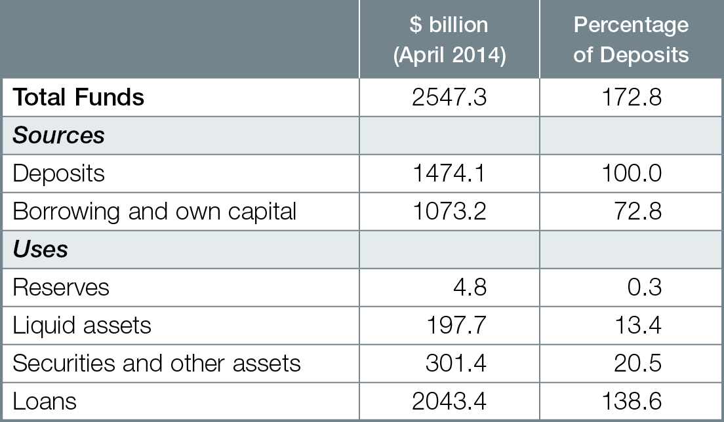
Chartered Banks: Sources and Uses of Funds

Slide 19
Banks face a trade-off between profits and prudence
More potential profits by holding smaller fraction of reserves, making more loans, making higher-risk loans
Trade-off is giving up safety and risking customers’ deposits and trust
Supply of money determined by Bank of Canada AND chartered banks
Quantity of money supplied depends on quantity of loans and demand deposits banking system creates
When interest rate rises, quantity of money supplied increases
Higher interest rates makes loans more profitable, so banks loan more, creating more demand deposits

Slide 20
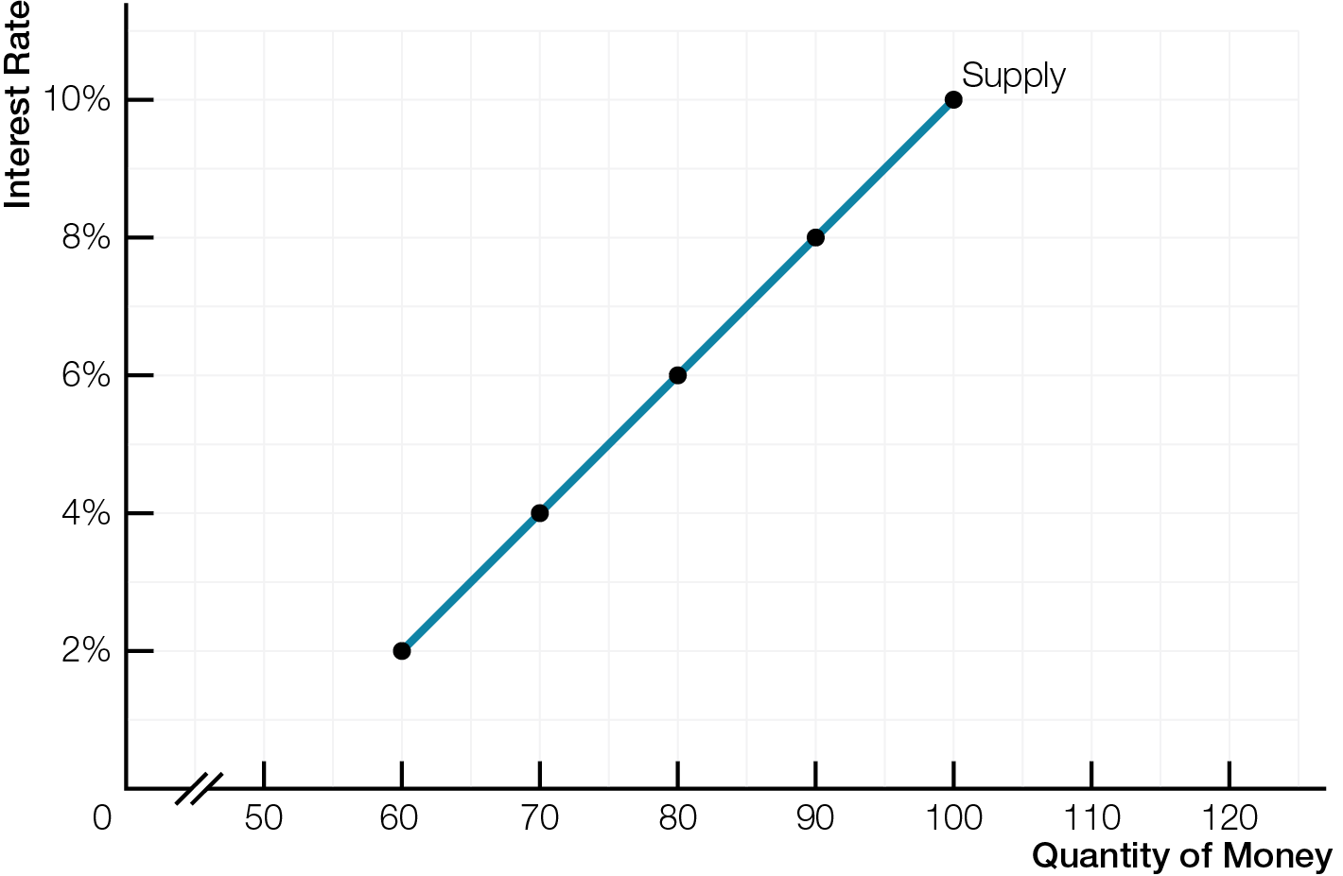
Supply of Money

Slide 21
INTEREST RATES, MONEY AND BONDS
Bond prices and interest rates are inversely related and determined together in the money and loanable funds markets.

Slide 22
The interest rate is the price of money in two ways
Opportunity cost of holding money
Cost of borrowing money
Bonds promise to pay back the original value plus a fixed dollar amount of money
Bonds do not promise a fixed percentage of interest
When holding a bond until its time period is up, you receive the promised, fixed dollar amount payments plus the original value

Slide 23
Market price of a bond changes when interest rates change
When interest rates rise, market price of a bond falls
When interest rates fall, market price of a bond rises
Amount of Money Available in n Years
=
Present Value (Price of Bond)
(1 + Interest Rate)^{n}

Slide 24
PERPETUITY BONDS
Simplest example of inverse relation between bond prices and interest rates
Pays fixed dollar amount forever, but never repays original investment
Price of Bond = fixed $ amount/year interest rate
$100 = $10/year 0.10
If interest rate rises to 20% (0.20), what is bond worth?
$50 = $10/year 0.20
continued…

Slide 25
Market price of a bond changes when interest rates change
Bonds are riskier and less liquid than money as a store of value, because the market price of the bond changes
Interest rate determined by the interaction of demand and supply in the money and loanable funds markets

Slide 26
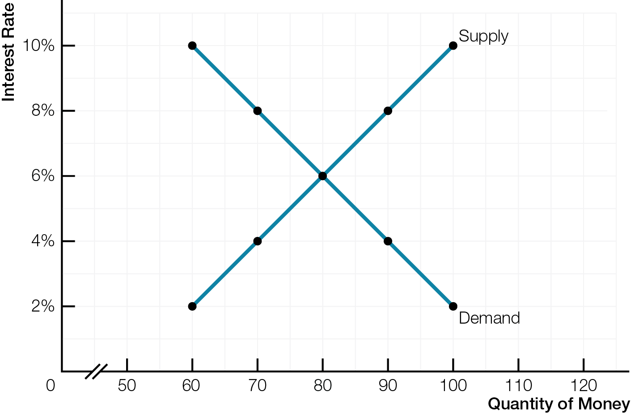
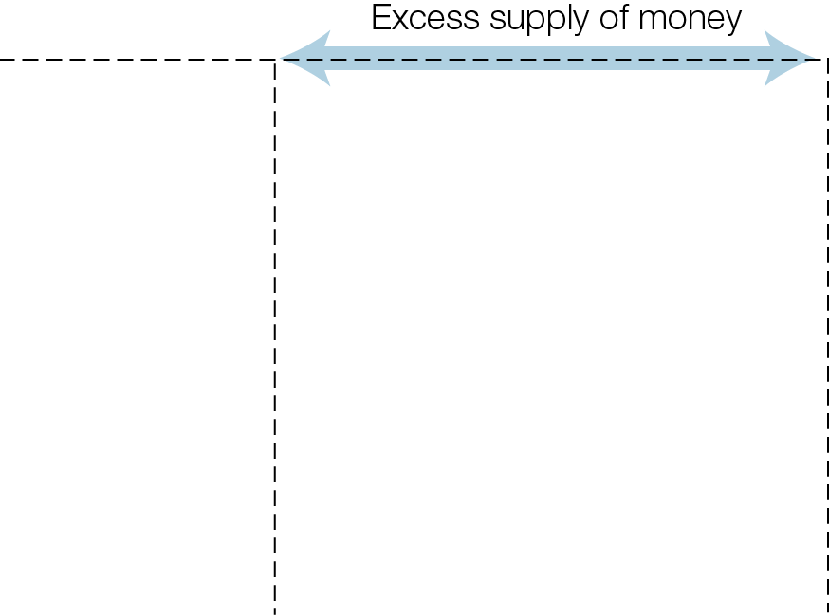
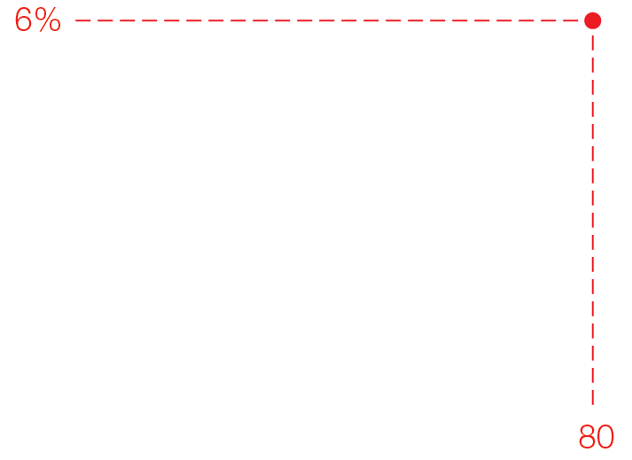
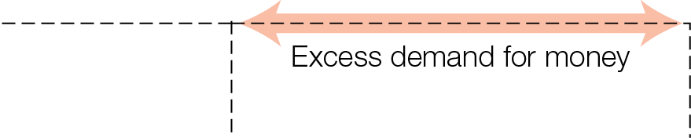
Demand and Supply for Money
Fig. 9.6

Slide 27
At equilibrium interest rate, quantity of money demanded equals quantity of money supplied
Below equilibrium interest rate, excess demand for money
People sell bonds to get more money; increased supply of bonds causes falling bond prices and rising interest rates
Above equilibrium interest rate, excess supply of money
People buy bonds to get rid of money; increased demand for bonds causes rising bond prices and falling interest rates
There are many interest rates on financial assets, but all tend to rise or fall together

Slide 28
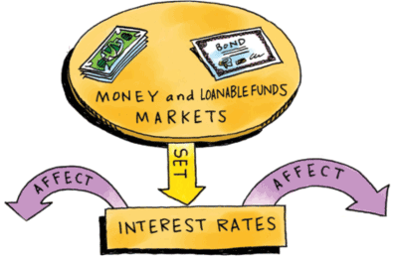
DOMESTIC TRANSMISSION MECHANISM
Money affects interest rates, domestic spending (consumption and business investment), and aggregate demand, which change real GDP, unemployment, and inflation.

Slide 29
How does money affect the key macroeconomic outcomes of increasing real GDP per person (economic growth), unemployment, and inflation ?
Money can affect inflation, according to quantity theory of money
But money does not directly affect aggregate supply or economic growth
Money does indirectly affect GDP, economic growth, and unemployment

Slide 30
Domestic monetary transmission mechanism how money indirectly affects real GDP through interest rates, spending, and aggregate demand
When interest rate falls, interest-sensitive purchases become cheaper; increased consumer spending (C) and business investment spending (I) increase aggregate demand
Lower interest rates are a positive demand shock, increasing aggregate demand, increasing real GDP, decreasing unemployment, and causing inflation
Higher interest rates are a negative demand shock, decreasing aggregate demand, decreasing real GDP, increasing unemployment, and causing deflation

Slide 31
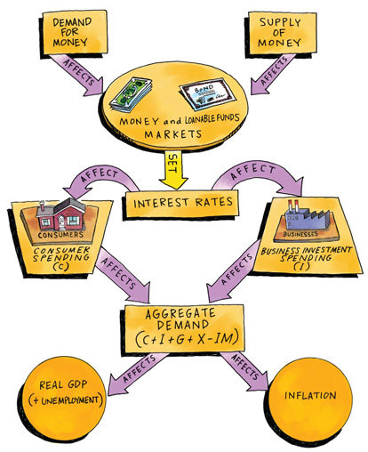
Domestic Money Transmission Mechanism

Slide 32
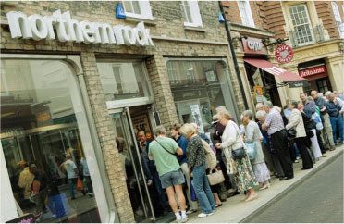
MONEY AND BUSINESS CYCLES
“Yes — Markets Self-Adjust” camp thinks money has no effect on business cycles and helps loanable funds markets adjust. “No — Markets Fail Often” camp thinks money creates new shocks and blocks the transmission mechanism, slowing market adjustments.

Slide 33

Economists disagree on the question “How much does money matter for business cycles and how quickly markets adjust?”
Yes — Markets Self-Adjust answers
Money does not affect external supply shocks that are main source of business cycles
Money allows savings to flow easily through loanable funds market to encourage business borrowing for investment spending
Money helps markets quickly adjust to equilibrium

Slide 34

No — Markets Fail Often answers
Money gives people a way not to spend but to save, creating the possibility of financial crises, adding new internal demand shocks for business cycles
Money blocks the domestic transmission mechanism so the loanable funds market does not match spending to saving
Money slows markets’ adjustments to equilibrium

Slide 35
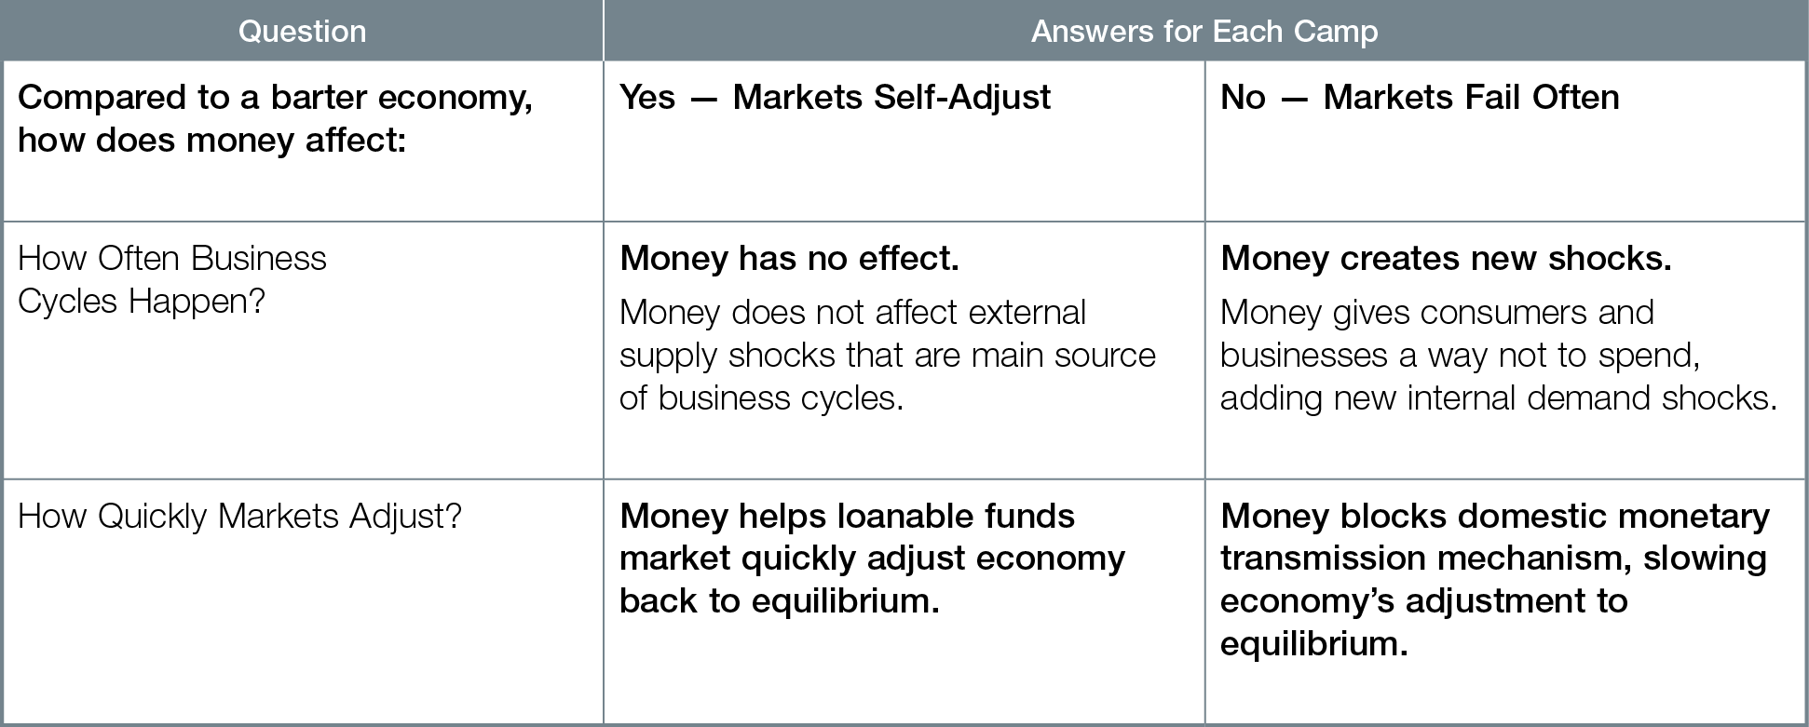
How Much Does Money Matter for Business Cycles and How Quickly Markets Adjust?

